Slide 1

Breast Cancer Prediction using - Feature Selection - Ensemble Voting

Slide 2
“ To prevent, detect, and treat breast cancer, and to improve the quality of life of both cancer patients and survivors. ”
- The most common cause of cancer

Slide 3
Data preparation
01
02
03
04
Missing Value Checking
Class Imbalance Checking
Normalization Checking
Correlation Checking
Ensures model is not affected by missing dataset
No missing data
Ratio bt. Benign (B) & Malignant (M) is 63:37.
Gap of 0.26.
Hence not imbalanced.
All variables should have the same scale for fair comparison between them.
Feature scaling used.
Based on the correlation matrix values above 0.7 indicate a high correlation.
Hence PCA used.

Slide 4
Feature Scaling
Wide range of values of raw data will affect the result of PCA and final model.
Scaling was performed so that each feature contributes approximately proportionately to the final distance

Slide 5
Principal Component Analysis
Principal Component Analysis (PCA) is a feature extraction technique which takes an orthogonal transformation to convert a set of observations of possibly correlated parameters into a set of values of linearly uncorrelated parameters called principal components
6 components account for 88.56%
Notes:
Here we perform feautire extraction over feauture extraction as we need all the data attributes
For our dataset, based on the correlation matrix (Figure 3), values above 0.7 indicate a high correlation between each two features which will bias the result. In this situation, principal component analysis needs to be performed.
Subsequently, we use these 6 components as our new features to build the model
We use filter method here and not embedded methods as dataset is small

Slide 6
Train/Test Split
7
3
Training data
Testing data
:
Model Engineering Cross Validation
To minimise the out-of sample error and improve the precision of the model, Cross-Validation is performed on the training and testing data by using multiple tests sets and average the out-of-sample errors

Slide 7

Models used to predict
SVM TUNING
LOGISTIC REGRESSION
ADABOOST
STOCHASTIC GRADIENT DESCENT
PERCEPTRON
XGBOOST
RANDOM FOREST
KNN
EXTREMELY RANDOMIZED TREES
ENSEMBLE VOTING CLASSIFIER

Slide 8
FEW Models
SVM
Random forest
KNN
Adaboost
Saturn is the ringed planet
Earth is the planet we live on
Despite being red, Mars is cold
Venus has a beautiful name
Notes:
Random forest - is an ensemble classifier that consists of many decision trees and outputs the class that is the mode of the class's output by individual trees. – bagging – majority voting
KNN – grouping clusters
Adaboost - We adaptively weigh each data case. - Weighted Voting
SVM -

Slide 9
Voting
Hard voting is the simplest case of majority voting, which is widely used in classification tasks.
Every individual classifier votes for a class, and the majority wins. In
Notes:
In soft voting, every individual classifier provides a probability value that a specific data point belongs to a particular target class. The predictions are weighted by the classifier's importance and summed up. Then the target label with the greatest sum of weighted probabilities wins the vote.

Slide 10
Metrics
ROC
Precession, Recall & F1 score
Accuracy
Notes:
If on a small percentage of the population, let's say one percent have this disease, if the model shows they are healthy all the time, then it is right on 99 percent of the data points. So the model is 99 percent accurate but zero percent useful.
Precesion and recall deals with true positives and false positives this over comin the problem of accuracy in imbalanced data.
Unfortunately, precision and recall are by nature are indirectly [roprtional. That is, improving precision typically reduces recall, and vice versa.
Hence we merge them and use the F1 score.
ROC provides a simple way to summarize all the confusion matrix. Where we plot true positive in x axis and false positive in y axis.

Slide 11
TOP MODELS
SVM
Logistic regression
Ensemble voting
Acc | Prec | Recall | F1
97.250 | 0.970 | 0.970 | 0.970
Acc | Prec | Recall | F1
96.740 | 0.980 | 0.980 | 0.980
Acc | Prec | Recall | F1
97.480 | 0.980 | 0.980 | 0.980

Slide 12
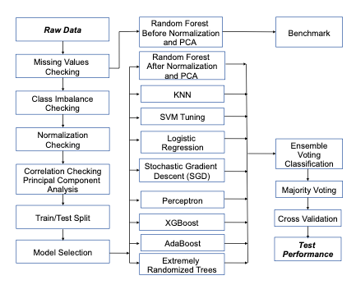

Notes:
Thus we predicted the tumour using multiple models and found which works the best for our data !

Slide 13
Thank You !
Hope we provided a breakthrough to deal with the disease

